Slide 1
Peer Observation and Feedback:
A Collegial Approach to Teacher Learning
Sara Hadfield, MA TESL
sehadfield@msn.com
Alaska Adult Ed. Association Fall Conference
October 3, 2019
Credit: Getty Images
Notes:
Tell name; Google slides presentation: will take you through; send around contact sheet (I’ll send you slides) or you may email me.

Slide 2
Table of Contents
Topic/resource Slide Topic/resource Slide
Presentation Outline 3 Observation Form and Post-Observation Review Questions, CAELA 22
Introduction 4 Template: Teacher Notes From Feedback Meeting, Veritas College Prep 23
Effective PD, per Darling-Hammond 5 “Models of Peer Observation of Teaching,” David Gosling. 24
TESOL Standards of ESL/EFL Teachers of Adults 6 “Teacher Development Through Deliberate Practice,” TNTP 25
TESOL Principle 6 for Exemplary Teaching 7 “Teachers Observing Teachers,” Education World. 26
Standards For Alaska’s Teachers 8 “Rethinking Classroom Observation,” Grimm, Kaufman & Doty 27
Cambridge English Teaching Framework 9 “Five Activities for Peer Observation,” Oxford U. ELT Blog. 28
Cambridge Framework Component Descriptors 10 Observing Teachers and Facilitating Their Growth Through Conferences
Peer Observation: Definition and Benefits, per British Council 11 Christopher Stillwell (webinar) 29
Initiating Peer Observation Partnerships 12 The Collaborative Development of Teacher Training Skills,” Stillwell 30
Sample Email: Invitation to Observe 13 How Would A Restaurant Reviewer Critique Student Writing?” Whitman 31
Guiding Principles: Pre-observation stage 14 Continuing Cooperative Development, Julian Edge 32
Guiding Principles: Observation stage 15 Advising and Supporting Teachers, Randall & Thornton 33
Guiding Principles: Post-observation stage (observer) 16 Internet Resource List: TNTP Teacher Talent Toolbox 34
Guiding Principles: Post-observation stage (observed) 17 Remembering the Goal (graphic and quote) 35
Video: From Teacher to Trainer and Beyond, Cambridge English 18 References 36-38
Pairwork: Guiding Questions 19
Additional Resources Section 20
Protocols and Advice for Giving and Receiving Feedback, VASSP 21
Notes:
These slides are not for my presentation only, but contain curated resources with links for your use after the presentation. This TOC is to help you find indiv. slides afterward.

Slide 3
Presentation Outline
Introduction
Theoretical basis
Peer observation defined
Guiding principles
My experience
Video analysis and discussion
Pairs: identify potential focus question
Additional resources and aids
Questions and answers

Slide 4
Introduction
Educators in general, and English language teachers (ELTs) in particular—both pre-service and in-service—can improve their teaching competence through learning that is content-focused, active, collaborative and job-embedded, uses modeling, provides coaching, offers opportunities for feedback and reflection, and is sustained (Darling-Hammond, et al, 2017). An effective form of teacher learning that meets these criteria is peer observation and feedback. The Cambridge English Teaching Framework (2014) includes “peer observation of and/or by a colleague” as a key competency for effective teaching (Components, 9).
Because classroom observation is commonly associated with assessing teachers’ job performance, ELTs may conceive of peer observation as a threat rather than a help to their praxis. Even if ELTs do view peer observation as beneficial theoretically, they may be ill-prepared to implement it effectively in their teaching context. This presentation, therefore, promotes peer observation as a collegial approach to teacher learning, equips participants to design and implement collaborative observation partnerships, demonstrates how such partnerships may practically function, and provides a takeaway of curated resources: articles, books, lists, charts, forms, a video, and even a webinar.
Notes:
1. Read intro. (abstract).
2. “Have any of you done p/o as a form of professional development? Was it + or - ? For those who are new to p/o, what thoughts/feelings does this topic conjure?
3. Background: I teach in an adult ESL program at UAA, rural comm. campus; interested in developing as teacher, continually increasing knowledge and skill; Began exploring ways to bring PD to my dept, saw need for devt; read re: value of collaborative, job-embedded PD; took survey of colleagues; wanted obs. w/ feedback & dialogue w colleagues, at least 1X/sem. Have begun to implement, invited colleagues to observe me; implemented in student teacher mentorship. Hope to share what I’ve learned and inspire other ELT’s to give it a try. B4 getting into nuts & bolts of p/o, let’s look at the theoretical basis.

Slide 5
Effective Professional Development (PD)
Darling-Hammond, et al (2017) identify seven characteristics of effective professional development (PD). Specifically, they find that it
● Is content-focused
● Incorporates active learning
● Is collaborative and job-embedded
● Uses models and modeling
● Provides coaching and expert support
● Offers opportunities for feedback and reflection
● Is of sustained duration
Teacher-to-teacher observation and feedback meet these criteria for effective PD.
Notes:
Explain each pt.; contrast with one-offs.
Additionally, a number of teacher standard frameworks serve as guides...

Slide 6
TESOL Standards
Standard 8 of the TESOL International Association (2008) Standards for ESL/EFL Teachers of Adults Framework states,
“Teachers continue to grow in their understanding of the relationship of second language teaching and learning to the community of English language teaching professionals, the broader teaching community, and communities at large, and use these understandings to inform and change themselves and these communities.” (emphasis added)
Notes:
Chose TESOL Standards for Adults since that is my context, but you may find similar standards for teachers in your context because many characteristics of a good teaching span across contexts.

Slide 7
TESOL’s Principle 6 for Exemplary Teaching
https://www.tesol.org/the-6-principles/the-6-principles/principle-6
Engage and Collaborate within a Community of Practice
Exemplary teachers
● collaborate with others in the profession to provide the best possible support for their learners.
●meet with colleagues to co-plan and share their expertise.
● participate in continuous learning and ongoing professional development.
● reflect critically on their own classroom practices.
Examples: observing, coaching, mentoring; modeling a lesson or technique for colleagues
Notes:
Additionally, TESOL’s Principle #6 of the 6 Principles for Exemplary Teaching is instructive:

Slide 8
Alaska
Teacher
Standards
The Standards for Alaska's Teachers (1997) lists teacher performances consistent with peer observation and feedback such as engaging in thoughtful and critical examination of teaching practice and working cooperatively with colleagues.

Slide 9
Cambridge English Teaching Framework
http://www.cambridgeenglish.org/images/165722-teaching-framework-summary-.pdf
This framework (UCLES, 2014) outlines four stages of teacher development, from Foundation to Expert, and five categories of teacher knowledge and skills. Each category describes the key competencies for effective teaching at each stage. Use the framework to see where you are in your development and where you want to go next.
Area #5, Professional Development and Values, is instructive here.
(Cambridge Framework continued on next slide)
Notes:
Read slide.
Show chart and explain.

Slide 10
Cambridge English Teaching Framework, continued
https://www.cambridgeenglish.org/images/172991-categories-and-components-cambridge-english-teaching-framework.pdf
Area #5, Professional Development and Values, includes the following areas of knowledge and competence:
Classroom observation
Includes recognizing the importance of different types of classroom observation for one’s professional development and seeking opportunities for constructive feedback and learning.
Reflecting on teaching and learning
Includes critically reflecting on teaching, developing the habit of seeking regular feedback, and acting on the results to ultimately improve student learning.
Teamwork and collaboration
Includes seeking support and guidance from others and providing support and guidance to other teachers.
(Cambridge English Framework Components, 2014, pp. 9-10)
Notes:
Summarize slide.
Now that we’ve looked at some some standards, let’s talk about what peer observation and feedback is and is not.

Slide 11
Peer Observation: Definition and Advantages
https://www.teachingenglish.org.uk/article/peer-observation
In this introductory article to peer observation (British Council, 2010), Graham White defines peer observation and points out its benefits:
Peer observation = observation of teachers by teachers
Experienced with novice (mentoring)
Novice observes and is observed
Experienced with experienced
Reflect on teaching in a private, supportive environment
Teacher development emphasized; not evaluative. Institution remains uninvolved in outcomes of observation or issues discussed.
Advantages for teachers:
Opportunity to learn from each other in a non-threatening environment; atmosphere of trust; sharing ideas constructively to their mutual benefit (White, p. 3).
Advantages for institutions:
Powerful tool for nurturing good practice throughout an experienced staff; helps less experienced teachers improve their teaching skills and absorb the values of the institution (White, p. 4).
Notes:
re: institutions, supervisors can leverage the powerful assets they have in their own dept.: experienced teachers with wealth of knowledge and skills.

Slide 12
Initiating Peer Observation Partnerships
A cooperating teacher may suggest it to a student teacher (collegial development; not evaluative).
Experienced with less experienced in-service teacher (mentoring--either may initiate)
Experienced teacher may ask an experienced colleague to observe--can break the ice and lead to opportunities for reciprocity.
An experienced teacher may offer to observe colleague if the opportunity presents itself.
Supervisors may implement partnerships amongst their teaching staff.
One or more teachers may introduce the concept to colleagues and/or director.
Look for opportunities, and approach others naturally. Put relationships above programs.
Notes:
1.*Pt. 2 important--unpack.
2. Tell that I had a real-life teaching challenge. Thought it a good time to try out p/o. Sent email (see next page).

Slide 13
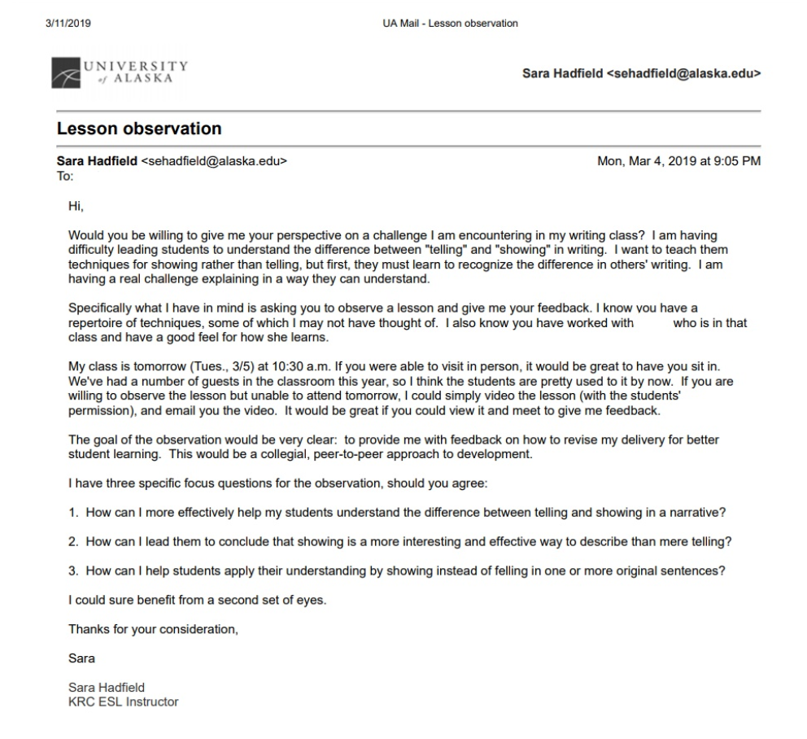
Sample Email: Invitation to Observe
Notes:
-Point out 3 focus questions--make the observation very clear-cut.
-She was happy to help.
-Discussed protocol over the phone prior to class (next slide).

Slide 14
Guiding principles for pre-observation, observation, and post-observation
drawn from White (2010), Stillwell (2017), and VASSP Project Services (n.d.)
Pre-observation stage: Setting the stage
● Consider the match; both observed and observer should have input.
● Build trust and show engagement (both parties) through listening skills, body language.
● Choose a focus (observed should take the lead, may need help to define); a specific focus question/-s can guide.
● Provide observer with background info. regarding the class, overview and goals of the lesson, anticipated problems, etc.
● Decide whether to introduce observer to class and whether observer will intervene at any point.
● Determine means of data collection: Notes? Video? Audio?
● Agree on confidentiality (observation is formative, not summative).
● Decide how you will end the observation. Agree to reserve feedback comments for post-observation conference.
● Determine specifics: date, time, place, position in room, etc.
● Establish time and place for post-observation conference.
Notes:
Can be done in person or over the phone.
Re focus: -What is the observed hoping to gain: advice, praise, confirmation, problem solving, shared journey, etc.?

Slide 15
II. Observation stage: Instruction in action
● Observer arrive early, minimize intrusion into the class, sit in unobtrusive spot.
● Carry out lesson as naturally as possible. Stay flexible if things don’t go entirely as planned.
● Observe with specific feedback in mind (remember the focus).
● Both parties keep in mind this is FORMATIVE; maintain collegial stance.
● At the end, remember to save comments for the agreed-on follow-up meeting.

Slide 16
III. Post-observation stage: The feedback meeting
For the observer:
● Remember body language.
● Think about the impact of what you say; choose words carefully.
● Focus on the content, not the person.
● A good place to start is with the observed teacher’s experience. “How do you feel it went?”
● Don’t make many value statements (good, bad, etc.); don’t deny the observed the agency to arrive at own conclusions.
● Keep comments and questions descriptive rather than evaluative, but do affirm what went well.
● Guide the reflection with statements like “I noticed on two occasions…. Tell me about that.”
● Check that your observations are accurate. “It appeared that…. Would you agree?”
● Let the observed talk a lot; keep it conversational and “student” centered; avoid sounding like the expert.
● Help observed prioritize areas of improvement; avoid a laundry list.
(For more on the nuances of communicating feedback, refer to Stillwell’s webinar (2017).
Notes:
Remind that the VASSP document, White, and Stillwell have lots more detailed suggestions

Slide 17
Post-observation stage, cont.
For the observed:
● Focus on the content, not the person.
● Remember body language and staying engaged.
● Actively participate in reflection and discussion; keep it conversational.
●Take the lead in identifying action points and make a plan to carry them out.
● Ask for clarification if needed. “What I hear you saying is…. Is this correct?”
● A criticism many not be reality, but the perception can be acknowledged and addressed.
● Avoid defending; welcome suggestions; see the session as professional learning.
For both:
● Consider means of ongoing reflection: follow-up observation? Further discussion? Other means?
Notes:
In my story, we followed up with feedback conference. Gave me many good things to think about. I felt the second time, the students got it, but needed confirmation; 2 pair of eyes. Bonus: she said she learned a lot from sitting in on my class (beyond the focus) and expressed it would be nice to have someone do the same for her so she can continue to grow. Met 2y goal of establishing culture of collegiality.

Slide 18
Video: From Teacher to Trainer and Beyond
https://www.youtube.com/watch?time_continue=1980&v=oouhRbC_icI
Now that we have covered the theoretical basis for peer observation and feedback, considered what it is and is not, noted advantages, and reviewed guiding principles, let’s observe this video clip (Cambridge English Trainer Framework, 2016) of a post-lesson discussion between two teachers (here, a teacher and trainer). Consider:
Who suggests the action points?
What do you notice about the relationship between teacher and trainer?
(Instead of a chat box, weigh in with your own responses aloud).
Note: For the purpose of this presentation, watch only 33:00-36:07.
Notes:
Read slide; play video; pause for “chat box” answers, end at 35:22.
It was the teacher who came up with her own action pts.
Interaction: sitting side-by side; trainer is friendly, encouraging; trainee feels comfortable. Trainer gets teacher to talk about her lesson; prompts w Q’s: “Why did you decide to…?” “Did you notice…?” Encouraged teacher to give her views 1st, dev. self-awareness.

Slide 19
Pairwork: Guiding Questions
Now think about your own teaching praxis.
Pair up with someone next to you and share questions you may have about your teaching. Identify concepts, techniques, cognitions, etc. about which you might invite a peer observer to offer feedback.
Teacher trainers may also identify areas for personal growth (observing the observer).
Notes:
Think about recent scenarios in the classroom. Ex: Too much teacher talk? How can I make this lesson more interesting/engaging? Get students to take more ownership over their learning? How is my response to students who come late or unprepared? Cultural issues affecting how students respond that I’m not recognizing? 3 minutes; 3 volunteers.

Slide 20
Additional resources
The slides that follow offer curated resources for your further study and application.

Slide 21
Protocols and Advice for Giving and Receiving Feedback on Classroom Performance
Protocols and Advice for Giving and Receiving Feedback on Classroom Performance
Here is a handy list of points by VASSP Project Services for setting agreed-on protocols prior to the observation and subsequent feedback session so observer and observed know what to expect. There are also points for structuring thoughtful, constructive feedback.

Slide 22
Center for Adult English Language Acquisition (CAELA)
Observation Form and Post-observation Review Questions
https://files.eric.ed.gov/fulltext/ED505392.pdf
Included in this short article from CAELA (2009) are two practical, ready-to-use aids: a lesson review form on p. 4 and an observation checklist on pp. 5-6 for reflection by both observer and observed. The latter is more structured and detailed while the former is more open-ended.
The article also contains information about different types of observation, including collaborative peer observation. The author refers to a supervising teacher, though the model can equally be used between peers. There are ideas for questions the observed teacher might ask the observer to pay attention to from the outset as well as questions for reflection afterward.

Slide 23
Template: Teacher Notes from Feedback Meeting
Template: Teacher Notes from Feedback Meeting (Veritas College Prep)
Here is a form for the observing teacher’s feedback notes, including skills to model, areas to help the teacher practice, and items to deliver to the teacher.

Slide 24
Chart: “Models of Peer Observation of Teaching”
https://www.researchgate.net/publication/267687499_Models_of_Peer_Observation_of_Teaching?enrichId=rgreq-f34fdc27d1072346c91797880e6df8ec-XXX&enrichSource=Y292ZXJQYWdlOzI2NzY4NzQ5OTtBUzoxNjA0OTE4NTkwOTU1NTJAMTQxNTI3NTY0OTEyNw%3D%3D&el=1_x_2&_esc=publicationCoverPdf
On p. 5 of David Gosling’s (2002) article is a useful chart for comparing the peer review observation model against the evaluation or development models.

Slide 25
Article: “Teacher Development Through Deliberate Practice”
https://tntp.org/assets/tools/Deliberate_Practice_TNTP_6JUN2013.pdf
This short article from TNTP’s Teacher Talent Toolbox shows that focused practice with feedback within a teacher’s own classroom leads to instructional improvement. Deliberate practice with the aid of a coach or peer to model and provide feedback as well as reflection and repetition can bring about lasting improvement in teaching skills and techniques.

Slide 26
Article:
“Teachers Observing Teachers: A Professional Development Tool for Every School”
http://www.educationworld.com/a_admin/admin/admin297.shtml
This article from Education World shows how teachers observing teachers--as a form of PD--improves teaching practice and student performance. The author shows how observed teachers can use observation for modeling: showing rather than telling.

Slide 27
Article: “Rethinking Classroom Observation”
http://www.ascd.org/publications/educational-leadership/may14/vol71/num08/Rethinking-Classroom-Observation.aspx
In this article, Grimm, Kaufman, and Doty (2014) show how peer observation leads to job-embedded teacher learning. The authors explain how teachers engage peers in gathering and analyzing classroom data through observation as a tool for refining their own instruction. The observed teacher is the force behind this “flipped” model of peer observation.

Slide 28
Article: “5 Activities for Peer Observation”
https://oupeltglobalblog.com/2017/03/09/5-activities-for-peer-observation/
This article from Oxford University Press’ ELT blog (2017) gives suggestions for 5 innovative ideas for peer observation.
Notes:
Change it up

Slide 29
Webinar:
Observing Teachers and Facilitating Their Growth Through Conferences
http://www.tesol.org/connect/tesol-resource-center/search-details/virtual-seminars/2017/11/08/observing-teachers-facilitating-their-growth-through-conferences
In this webinar, Christopher Stillwell (2017) discusses the stages of teacher observation and the principles that make it most effective, from pre- to post-observation conferences and beyond.
This was originally delivered live via TESOL International but is now available in recorded form.
*NOTE: To access this webinar, you must be a member of TESOL International Association. (Join today!)

Slide 30
Article: “The Collaborative Development of Teacher Training Skills”
https://academic.oup.com/eltj/article-abstract/63/4/353/679175?redirectedFrom=PDF
Another resource by Christopher Stillwell (2009) on using peer observation in the training of teacher educators. This link takes you to ELT Journal where you will find an abstract. To view the whole article, you must subscribe to ELT Journal or purchase short-term access.

Slide 31
Book Chapter:
“How Would A Restaurant Reviewer Critique Student Writing?”
http://sites.tesol.org/bookstore/ItemDetail?iProductCode=073E&Category=EBOOK
Christopher Stillwell’s (2013) book, Language Teaching Insights from Other Fields:
Sports, Arts, Design, and More contains a chapter by restaurant reviewer
Sylvia Whitman that he references in his webinar. It is available here from TESOL
Press in print or pdf format. Think of Whitman’s advice in terms of giving feedback
to a fellow teacher. Interesting insights into many facets of English language teaching
may be gleaned from other fields.
Note that from the TESOL Press site, you can peruse the book’s table of contents and
preview a chapter.
Notes:
Could look for this here at the the TESOL book store.

Slide 32
Book: Continuing Cooperative Development: A Discourse Framework for Individuals as Colleagues
https://www.amazon.com/Continuing-Cooperative-Development-Individuals-Colleagues/dp/0472088238/ref=sr_1_5?s=books&ie=UTF8&qid=1529710595&sr=1-5&keywords=edge%2C+julian
Here is the item detail of a book by Julian Edge (2002) which Stillwell references.
In Continuing Cooperative Development, a series of guided tasks helps readers acquire
specific skills of listening and responding to colleagues that they can use to take
individual control of their own development and increase the feeling of collegiality
in their workplace. Edge demonstrates how this interactive framework can be part of a
reflective teaching approach in response to everyday classroom issues. Note that you can
look inside the book and read the introduction and beginning of Chapter 1.

Slide 33
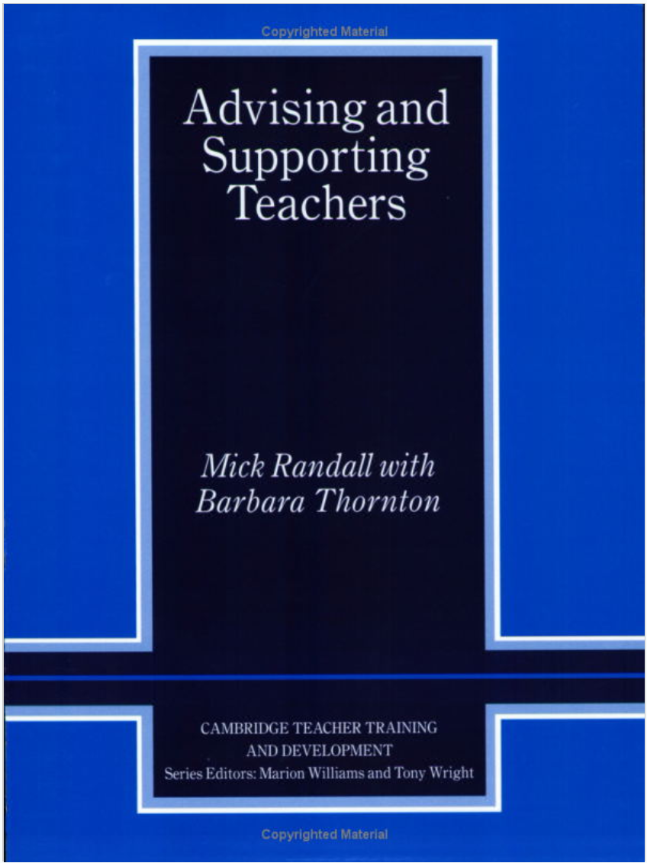
Book: Advising and Supporting Teachers
https://www.amazon.com/Advising-Supporting-Teachers-Cambridge-Development/dp/0521638968/ref=sr_1_1?ie=UTF8&qid=1529717727&sr=8-1&keywords=Thornton+and+Randall+Advising+and+Supporting
Another of Stillwell’s recommendations, this book by Randall and Thornton (2001)
examines the role of teacher advisors and how they may develop the skills required
for producing effective feedback. This could also be used to inform peer advisors.
Again, the Amazon item detail is linked above. Note the ability to preview extensively:
you can look inside at the table of contents and index, preview a chapter, and peruse
the numerous photocopiable resources, including interactive tools for role play, case
studies, examples of note-taking methods, sample conversations, scenarios for group
problem-solving, sketches to illustrate body language, seating configuration plan, etc.

Slide 34
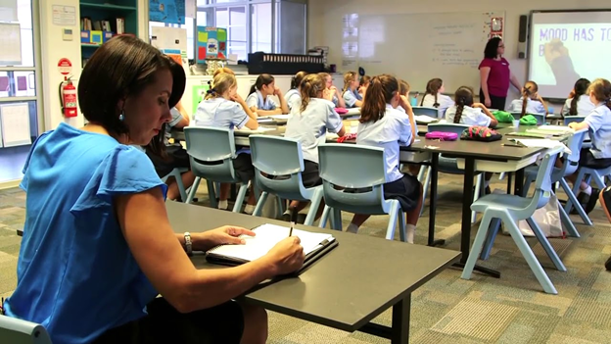
Internet Resource List
https://tntp.org/teacher-talent-toolbox/view/observation-and-feedback
https://tntp.org/teacher-talent-toolbox/view/observation-and-feedback
Finally, here is a “toolbox” of Internet resources for observation and feedback from TNTP.
Photo: https://i.ytimg.com/vi/-3eYi-iylD8/maxresdefault.jpg

Slide 35
Remember the goal...
“In planning professional development to
improve student learning,…you must plan ‘backward,’ starting where you want to end
and then working back.”
(Thomas R. Guskey, 2002, p. 50)
Graphic: https://encrypted-tbn0.gstatic.com/images?q=tbn:ANd9GcTWzNRDSbhF38uQxd9yiOVLgDkYDKlgf-nmYCecqdx1svSU9XdM
Notes:
The ultimate goal is student learning; think about what you want your students to gain and use that to guide your coaching and mentoring of fellow teachers.

Slide 36
References
Alaska Department of Education and Early Development. (1997). Standards for Alaska’s Teachers.
Retrieved from https://education.alaska.gov/TeacherCertification/standards/pdf/teacher.pdf
Cambridge English Language Framework. (2014). Framework Components. UCLES. Retrieved from
http://www.cambridgeenglish.org/images/172991-categories-and-components-cambridge-english-teaching-framework.pdf
Cambridge English Teaching Framework. (2014). Summary Chart. UCLES. Retrieved from
http://www.cambridgeenglish.org/images/165722-teaching-framework-summary-.pdf
Cambridge English Trainer Framework. (2016). From Teacher to Trainer and Beyond. [Video file]. Retrieved from
https://www.youtube.com/watch?time_continue=1980&v=oouhRbC_icI
Clarke, Martyn. (March 2017). Five Activities for Peer Observation [Blog post]. English Language Teaching Global Blog. Oxford University Press. Retrieved from
https://oupeltglobalblog.com/2017/03/09/5-activities-for-peer-observation/
Darling-Hammond, L., Hyler, M.E., & Gardner, M. (2017). Effective Teacher Professional Development. Palo Alto, CA: Learning Policy Institute. Retrieved from
https://learningpolicyinstitute.org/sites/default/files/product-files/Effective_Teacher_Professional_Development_REPORT.pdf
Edge, J. (2002). Continuing Cooperative Development: A Discourse Framework for Individuals as Colleagues. University of Michigan Press ELT.
Gosling, D. (2002). Models of Peer Observation of Teaching. LTSN Generic Centre. Retrieved from Research Gate
https://www.researchgate.net/publication/267687499_Models_of_Peer_Observation_of_Teaching?enrichId=rgreq-f34fdc27d1072346c91797880e6df8ec-XXX&enrichSource=Y292ZXJQYWdlOzI2NzY4NzQ5OTtBUzoxNjA0OTE4NTkwOTU1NTJAMTQxNTI3NTY0OTEyNw%3D%3D&el=1_x_2&_esc=publicationCoverPdf
Notes:
Skip these, but mention they’re here.

Slide 37
(references, continued)
Grimm, E. D., Kaufman, T., & Doty, D. (2014). Rethinking Classroom Observation. Educational Leadership, 71(8), 24-29. Retrieved from
http://www.ascd.org/publications/educational-leadership/may14/vol71/num08/Rethinking-Classroom-Observation.aspx
Guskey, T.R. (2002). Does It Make a Difference? Evaluating Professional Development. Educational Leadership 59(6), 45-51. Retrieved from
http://www.ascd.org/publications/educational-leadership/mar02/vol59/num06/Does-It-Make-a-Difference%C2%A2-Evaluating-Professional-Development.aspx
Israel, M. (n.d.) Teachers Observing Teachers: A Professional Development Tool for Every School. Education World. Retrieved from
http://www.educationworld.com/a_admin/admin/admin297.shtml
Marshall, B. & Young, S. (2009). Observing and Providing Feedback to Teachers of Adults Learning English. Center For Adult English Language Acquisition (CAELA)
Network Brief. Retrieved from https://files.eric.ed.gov/fulltext/ED505392.pdf
Randall, M. & Thornton, B. (2001). Advising and Supporting Teachers. Cambridge University Press.
Stillwell, C. (2009). The Collaborative Development of Teacher Training Skills. ELT Journal, 63(4), 353-362. Retrieved from
https://academic.oup.com/eltj/article-abstract/63/4/353/679175?redirectedFrom=PDF
Stillwell, C. (2017) Observing Teachers and Facilitating Their Growth Through Conferences. [Webinar]. Retrieved from TESOL International Association on
http://www.tesol.org/connect/tesol-resource-center/search-details/virtual-seminars/2017/11/08/observing-teachers-facilitating-their-growth-through-conferences
TESOL International Association. (2008). Standards for ESL/EFL Teachers of Adults Framework. Retrieved from
https://www.tesol.org/docs/books/standards-for-esl-efl-teachers-of-adults-framework.pdf?sfvrsn=0
TESOL International Association. (2019). The Six Principles for Exemplary Teaching of English Learners. Retrieved from
https://www.tesol.org/the-6-principles/the-6-principles/principle-6.

Slide 38
(references, continued)
TNTP (n.d.) Resources: Observation and Feedback. Retrieved from https://tntp.org/teacher-talent-toolbox/explore/observation-and-feedback
TNTP (n.d.) Teacher Development Through Deliberate Practice. Retrieved from Teacher Talent Toolbox at
https://tntp.org/assets/tools/Deliberate_Practice_TNTP_6JUN2013.pdf
VASSP Project Services. (n.d.) Protocols and Advice for Giving and Receiving Feedback on Classroom Performance. Retrieved from
http://www.vassp.org.au/webpages/Project-services-docs/ June 24, 2018. (Link no longer valid)
Veritas College Prep. (n.d.) Template: Teacher Notes from Feedback Meeting. Retrieved from TNTP Teacher Talent Toolbox at
https://tntp.org/teacher-talent-toolbox/view/observation-and-feedback
White, G. (2010). Peer Observation. British Council. Retrieved from https://www.teachingenglish.org.uk/article/peer-observation
Whitman, S. (2013). How Would a Restaurant Reviewer Critique Student Writing? In C. Stillwell (Ed.), Language Teaching Insights from Other Fields: Sports, Arts,
Design, and More (Ch. 7). TESOL Press.

