Slide 2
AREA SERVED
SERVICES PROVIDED
High school completion, post secondary training and placement, work experience, vocational skills and supportive services
Fairbanks and interior region
DEMOGRAPHIC SERVED
HISTORY
Providing student-centered tutoring and classes in reading, writing, math, English as a second language, computer literacy and life skills
Out- of school youth

Slide 3
AREA SERVED
SERVICES PROVIDED
Anchorage, Mat-Su, Homer
GED/AE, High School Completion, work experience, employment, vocational training referral, and support services
HISTORY
DEMOGRAPHIC SERVED
The program provides services that prevent homelessness and improve the quality of life for all young Alaskans
Out- of school youth

Slide 4
AREA SERVED
SERVICES PROVIDED
High school completion support, work experience, post secondary healthcare skills training, and supportive services
Alaska Interior region
HISTORY
DEMOGRAPHIC SERVED
We introduce students to healthcare career opportunities, establish community-based training sites for students in service-learning and clinical capacities
In-school youth

Slide 5
AREA SERVED
SERVICES PROVIDED
Occupational skills training, job skill development, work experience and supportive services
Seward/ Statewide
HISTORY
DEMOGRAPHIC SERVED
Founded in 1969, AVTEC, trains a diverse and effective workforce to support the economic growth and stability of Alaska
Out- of school youth

Slide 6
SERVICES PROVIDED
AREA SERVED
Work experience, job skills training,
High school completion, transitional support,
Soft Skills, and supportive services
Anchorage/ Bethel
Fairbanks/ Juneau
HISTORY
DEMOGRAPHIC SERVED
DJJ provides WIOA services from four facilities located in: Anchorage, Juneau, Fairbanks, and Bethel
Youth Offenders:
Youth who commit a crime in Alaska and comes into contact with juvenile justice system.

Slide 7
The Learning Connection- SERRC
SERVICES PROVIDED
AREA SERVED
Individualized career and education plans and goal setting that often includes GED, trades training, work experience and Supportive services
Juneau
HISTORY
DEMOGRAPHIC SERVED
JobX has a 10+ year history providing academic and vocational services at SERRC’s Learning Connection
out-of-school youth in Juneau

Slide 8
AREA SERVED
SERVICES PROVIDED
Anchorage/ Statewide
Employability skills, high school completion, support services, and life skills
HISTORY
DEMOGRAPHIC SERVED
The academy works to lead, train, and mentor 16 to 18 year old youth in a quasi-military, 17 ½ month residential and non-residential high school setting
out-of-school youth

Slide 9
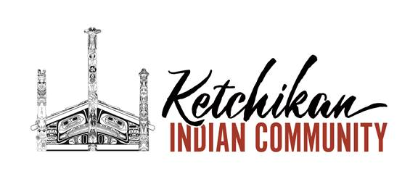
AREA SERVED
SERVICES PROVIDED
Ketchikan
Employability skills, high school completion assistance, support services, life skills, and scholarships
HISTORY
DEMOGRAPHIC SERVED
serves 6000+ tribal citizens and is second largest tribe in the State of Alaska- incorporated in 1940 under the Indian Reorganization Act of 1934
In school youth and out-of-school youth
.

Slide 10
AREA SERVED
SERVICES PROVIDED
Anchorage, Mat-Su, Fairbanks
Construction education, occupational skills training, work experience, and supportive services
HISTORY
DEMOGRAPHIC SERVED
AWP provides industry training, and employment matching for skilled workers.
out-of-school youth

Slide 11
YUKON DELTA FISHERIES DEVELOPMENT ASSOCIATION
AREA SERVED
SERVICES PROVIDED
Mt. Village, Emmonak, Kotlik, NunamIqua, grayling, and Alakanuk
Work experience, high school completion assistance, scholarships, Peer mentoring, suicide prevention and local employment placement
HISTORY
DEMOGRAPHIC SERVED
Independent fishing company creating employment opportunities for Yukon Delta residents. In 2018 Kwikpak Fisheries employed 624 residents including 173 students through the WIOA supported Youth Employment Project
.
In school youth and out-of-school youth

