Slide 1
Sheltered Instruction Observation Protocol:
Supporting Low Literacy and ELLs

Slide 2
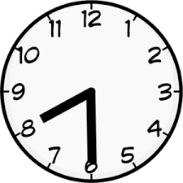
SIOP
Lesson Preparation
Building Background
Comprehensible Input
Strategies
Interaction
Practice/Application
Lesson Delivery
Review and Assessment

Slide 3
Building Background Knowledge

Slide 4
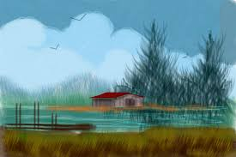
“Go to the water’s edge”

Slide 5
Part 1
Flip your paper over!
Put your pens and pencils down!

Slide 6
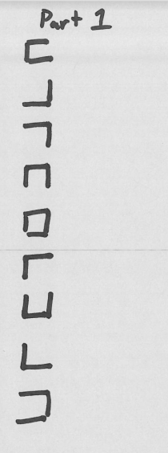
Part 1
Flip your paper back over.

Slide 7
The Background Knowledge:

Slide 8
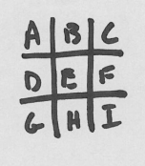
The context: (pattern, formula).

Slide 9
Part 2:

Slide 10
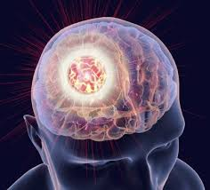
The more connections we can make to prior knowledge,
the faster we learn
and
the faster the information converts to long-term memory.

Slide 11
What does this look like in the classroom?

Slide 12
Picture this: a herd of elephants flies past you at sixty miles per hour, followed by a streak of tigers, a pride of lions, and a bunch of clowns. What do you see? It must be a circus train! One of the first uses of the circus train is credited to W.C. Coup. He partnered with P.T. Barnum in 1871 to expand the reach of their newly combined shows using locomotives. Before circus trains, these operators had to lug around all of their animals, performers, and equipment with a team of more than 600 horses. Since there were no highways, these voyages were rough and took a long time. Circuses would stop at many small towns between the large venues. Performing at many of these small towns was not very profitable. Because of these limitations, circuses could not grow as large as the imaginations of the operators. After they began using circus trains, Barnum and Coup only brought their show to large cities. These performances were much more profitable and the profits went toward creating an even bigger and better circus. Multiple rings were added and the show went on. Today, Ringling Bros. and Barnum and Bailey Circus still rely on the circus train to transport their astounding show, but now they use two.

Slide 13
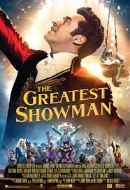
Background Knowledge Example:
2 minute trailer.

Slide 14
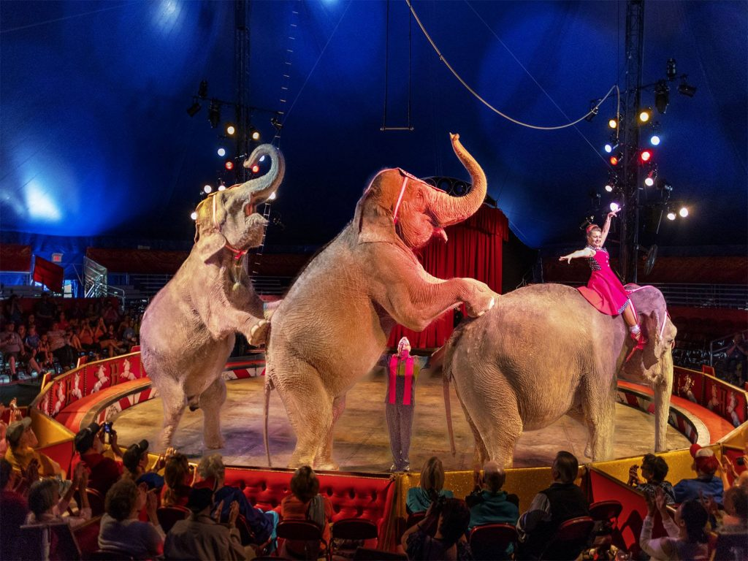
Have you been to the circus?
Would you like to go to the circus?
How does the circus travel from city to city?

Slide 15
Picture this: a herd of elephants flies past you at sixty miles per hour, followed by a streak of tigers, a pride of lions, and a bunch of clowns. What do you see? It must be a circus train! One of the first uses of the circus train is credited to W.C. Coup. He partnered with P.T. Barnum in 1871 to expand the reach of their newly combined shows using locomotives. Before circus trains, these operators had to lug around all of their animals, performers, and equipment with a team of more than 600 horses. Since there were no highways, these voyages were rough and took a long time. Circuses would stop at many small towns between the large venues. Performing at many of these small towns was not very profitable. Because of these limitations, circuses could not grow as large as the imaginations of the operators. After they began using circus trains, Barnum and Coup only brought their show to large cities. These performances were much more profitable and the profits went toward creating an even bigger and better circus. Multiple rings were added and the show went on. Today, Ringling Bros. and Barnum and Bailey Circus still rely on the circus train to transport their astounding show, but now they use two.

Slide 16
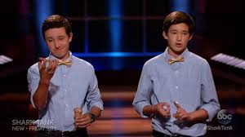
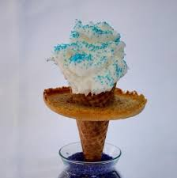
Background Knowledge Example 2:

Slide 17
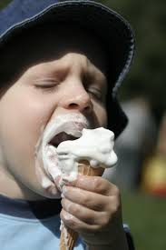
What is your favorite type of ice cream?
When was the messiest time you ate ice cream?

Slide 18
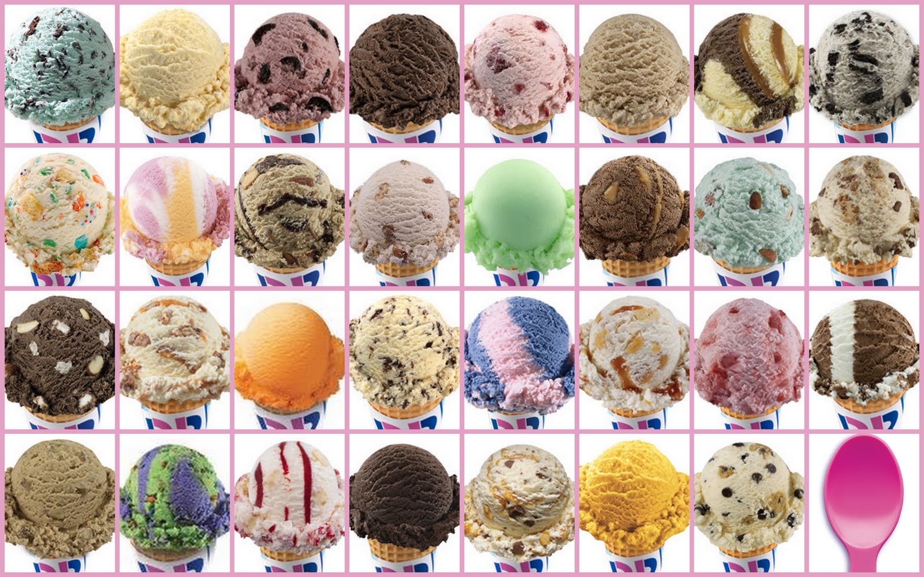

Slide 19
What is your favorite type of ice cream?
When was the messiest time you ate ice cream?

Slide 20
Background Knowledge Example 2:

Slide 21
Key concepts:
Use visuals
Personal connection
Think vocabulary

Slide 22
SIOP
Lesson Preparation
Building Background
Comprehensible Input
Strategies
Interaction
Practice/Application
Lesson Delivery
Review and Assessment

Slide 23
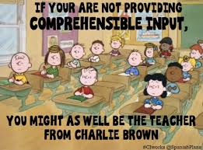
Comprehensible Input

Slide 24
Add Video Example:

Slide 25
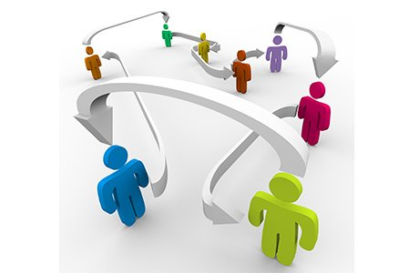
Interaction

Slide 26
List of Activities:
Gallery walk
4 corners
Fill in the gap
A-Z letter boxes
Question surveys
Strategic partnering

